Slide 1
Dual Inhibition of the Mur Ligases as a Promising Starting Point for the Development of New Antibiotics
Presentation to NIAID Nov 16 2020
Chris Dowson, University of Warwick
Joe Eyermann, Northeastern University
Lori Ferrins, Northeastern University
Matthew Todd, University College London

Slide 2
Our Aim
To discover small molecule inhibitors of the mur ligases, providing the starting point for the development of antibiotics with a novel mechanism of action.
Address the challenge of AMR by pursuing dual inhibitors, i.e. single compounds with activity against 2+ mur ligases.
Objective: Two late leads suitable for preclinical evaluation in the next 4/5 years, targeting ESKAPE pathogens, with initial emphasis on Enterobacteriaceae.

Slide 3
Why Multi-Target?
Successful monotherapeutic antibacterials
Not subject to single-step mutation to high level resistance because they target
Multiple related enzymes
Gene products that are multiply encoded
Substrates encoded by multiple enzymes
Current drugs inhibiting single enzymes
Generally used in combination because they are readily subject to single mutation resistance
Multi targeting mitigates against spontaneous resistance
1 target 1/10⁷
2 targets 1/10¹⁴ (size of the human microbiome)
3 targets 1/10²¹
B-lactams multiple PBPs
Fluoroquinolones gyrase, Topo IV
Macrolides 50S RNA
Oxazolidinones
Chloramphenicol
Pleuromutilins
Streptogramins
Lincomycins
Tetracycline 30S RNA
Aminoglycosides
Daptomycin membranes
Polymyxin
Metronidizole DNA
Glycopeptides lipidII

Slide 4
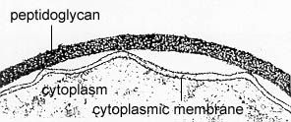
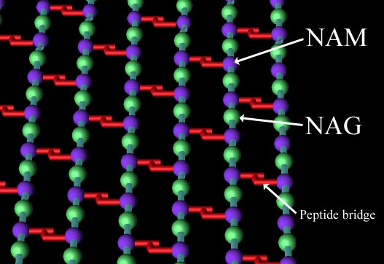
Cellular Compartmentalization of Peptidoglycan Biosynthesis
Cytoplasmic
Synthesis of a UDP-Sugar
Pentapeptide
Mur Ligases
Membrane-bound
Attachment to a lipid carrier,
addition of an extra carbohydrate
and crosslinking amino acids
Extracytoplasmic
Crosslinking of carbohydrate and
pentapeptide to yield final polymer

Slide 5
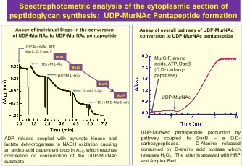
Target: Dual Inhibition of Mur Ligases
Mur ligases: a set of essential bacterial enzymes involved in construction of the cell wall.
UDP GlcNac
Enoyl pyruvoyl
UDP GlcNac
UDP MurNac
UDP MurNacL-Ala
Fosfomycin
4-[(2-napthyl)methyl]
-D-Glutamate
UDP MurNacL-Ala
D-GluL-Lys/DAP
D-AlaD-Ala
UDP MurNacL-Ala
D-GluL-Lys/DAP
UDP MurNac
L-AlaD-Glu
D-Cycloserine

Slide 6
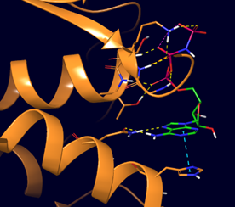
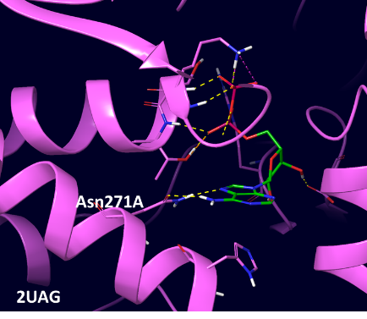
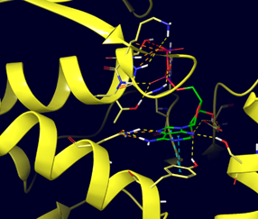
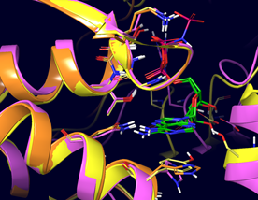
Mur ATP Binding Sites are Well Conserved
Aba murC
Eco murD
Mtb murE
6CAU
2XJA
murC/D/E
Percent identity and similarity of mur ligase ADP binding sites

Slide 7
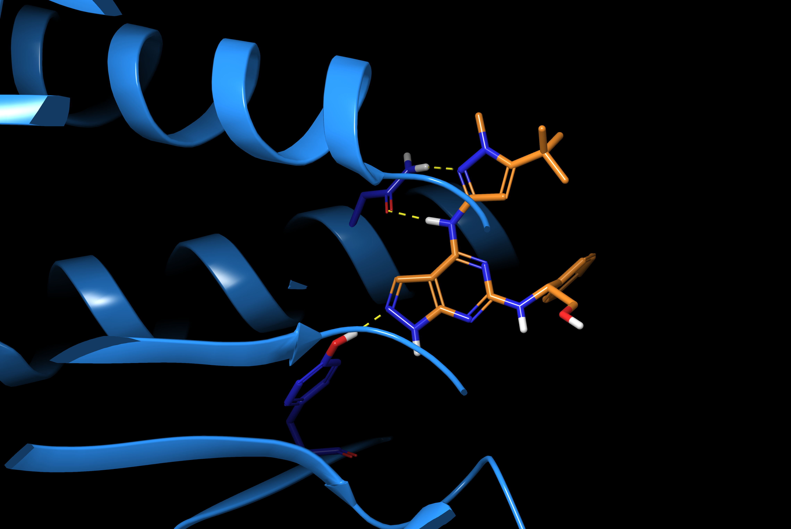

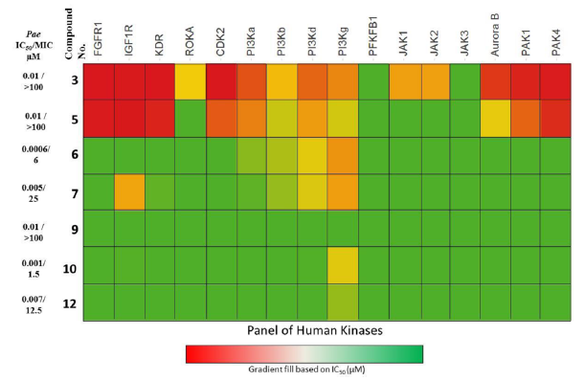
AstraZeneca Pyrazolopyrimidine P. aeruginosa MurC Inhibitors
Solved by SSGCID – released in September 2020
Establishes binding mode – models ambiguous
Confirms ‘kinase-like’ hinge binding mode
Insights for improving potency and modifying physprops
to address poor wild-type Gram-negative MICs
Provides impetus for fragment-based screen of “kinase
hinge binding” chemotypes
Clean human kinase profile:
N292
Pa murC
PDBID: 6X9N
Pae IC₅₀ 1 nM
Pae 545 MIC 1.56 uM (efflux mutant)
Eco 524 MIC 3.13 uM (efflux mutant)
Hameed P, S. et al. ACS Chem. Biol. 2014, 9, 2274−2282 (DOI: 10.1021/cb500360c)

Slide 8
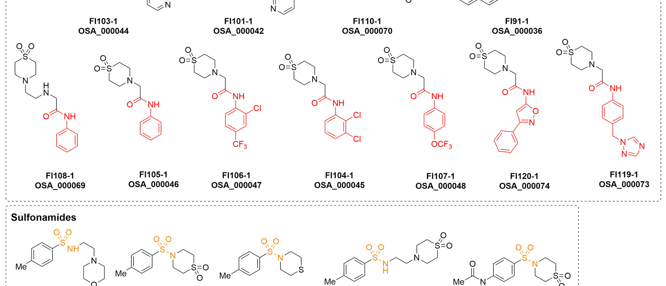
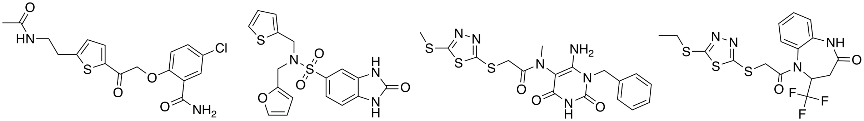
Preliminary Data from our Two Other Approaches
1. De novo design of lead compounds based on fragment screens vs Mur E at Diamond Light Source
2. Pro bono contribution from Atomwise of 92 novel small molecules vs ADP site of Mur E (now being evaluated)
https://github.com/opensourceantibiotics/murligase/wiki/Round-1

Slide 9
Specific Next Steps
Existing Starting Points
Lead optimization of unexplored AZ compounds targeted towards Gram –ves.
Evaluation and synthetic elaboration of Atomwise hits, as collaboration with Atomwise and local AI companies.
Evaluation of 600 Enamine-derived compounds designed vs ADP site of MurD.
Fragment Approach
Merge, elaborate hits based on Diamond data
New Starting Points
X-chem fragment screen of known kinase hinge binders vs murC and murD
Unexplored screening avenues (e.g. European Lead Factory call January 2021)
Build the Mur Ligase Community
Through a funded kernel, incentivize academic/industrial contributions/compounds

Slide 10

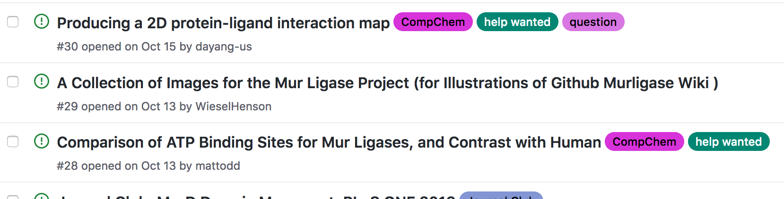
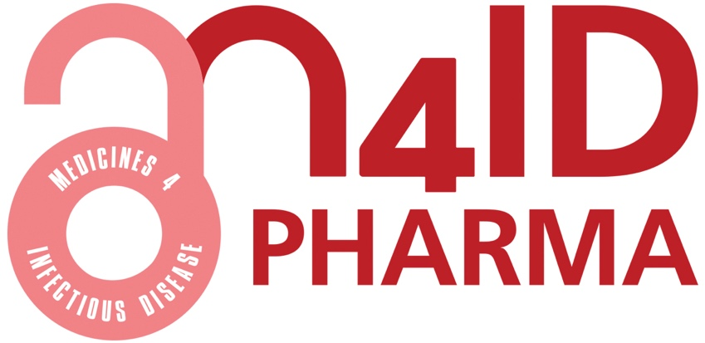
We Propose an Open Approach to the Research
Operations
All data and ideas shared in real time
Anyone may participate
No patents
(summarized in ChemMedChem, 2019, 14, 1804 (10.1002/cmdc.201900565))
License
Content: Creative Commons (CC-BY-4.0)
Samples: SGC click-wrap license (https://www.sgc-unc.org/request-idg-tools)
Translation Towards Inexpensive Medicines
Non-profit/NGO: “DNDi” model (adopted by antiviral organization READDI)
For-profit: Use M4ID pharma as a vehicle
(https://wellcomeopenresearch.org/articles/3-154/v1)
Funds: NCATS (US), MRC (UK), Carb-X

Slide 11
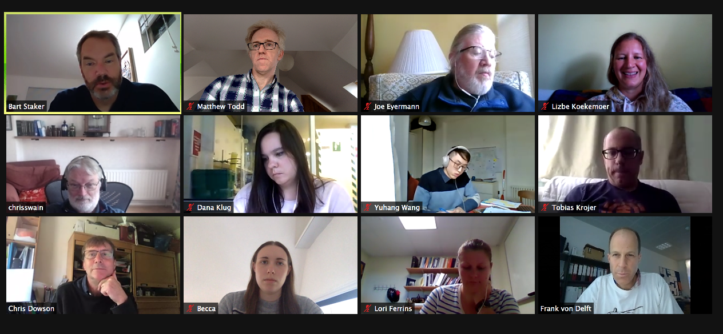
The Team and What We Need
Medicinal Chemistry: Matthew Todd (UCL, UK), Lori Ferrins (NEU, US)
Computational Design: Joe Eyermann (NEU and ex-AZ, US)
Protein Crystallography: SSGCID (Bart Staker, US), CSGID (Chicago, US), Diamond Light Source (Oxford, UK (Frank von Delft))
Enzymology: Chris Dowson (Warwick, UK)
DMPK: NEU via AZ/Charles River
Open Science: Matthew Todd (UCL, UK)
Existing other contributors: Chris Swain (Cambridge MedChem, UK), AI companies (Optibrium, GlamAI).
Resources
$2M over 4 years towards one late lead for an ESKAPE pathogen, complementing the in-kind resources we have assembled.
Additional $0.5M (1 year) to generate back-up late lead.

Slide 12
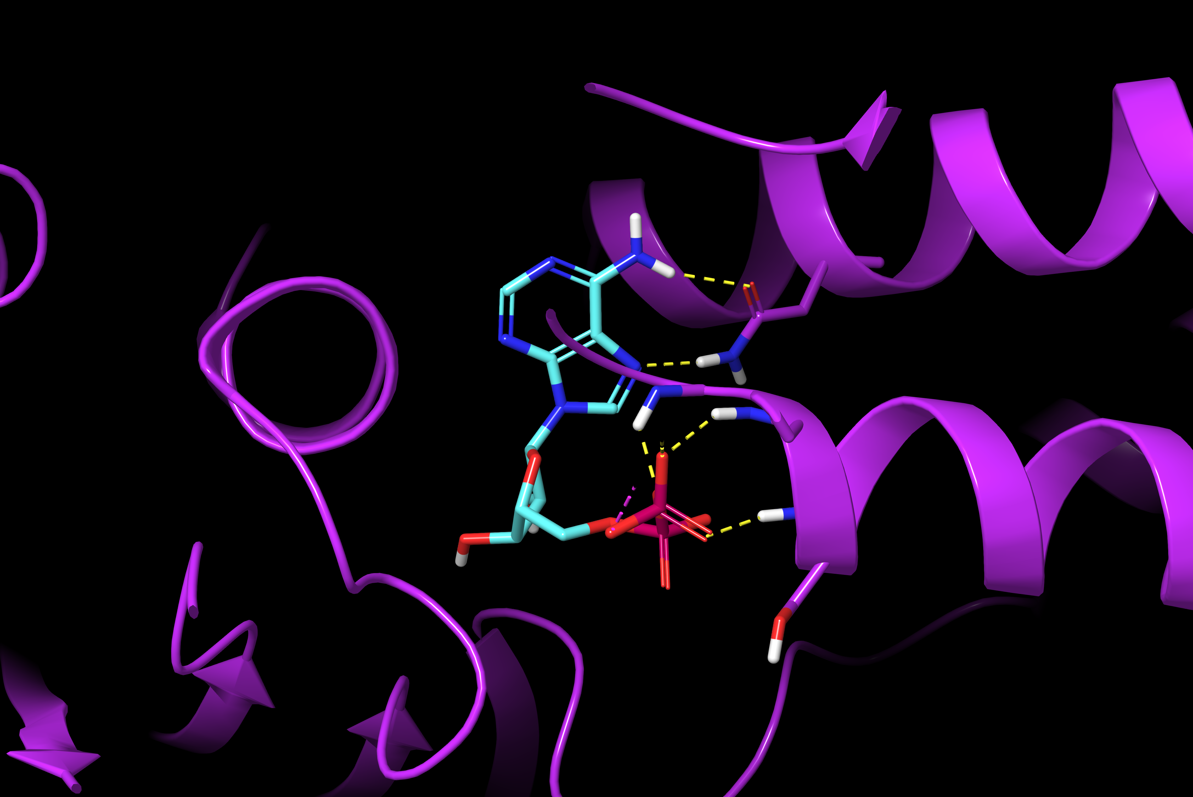
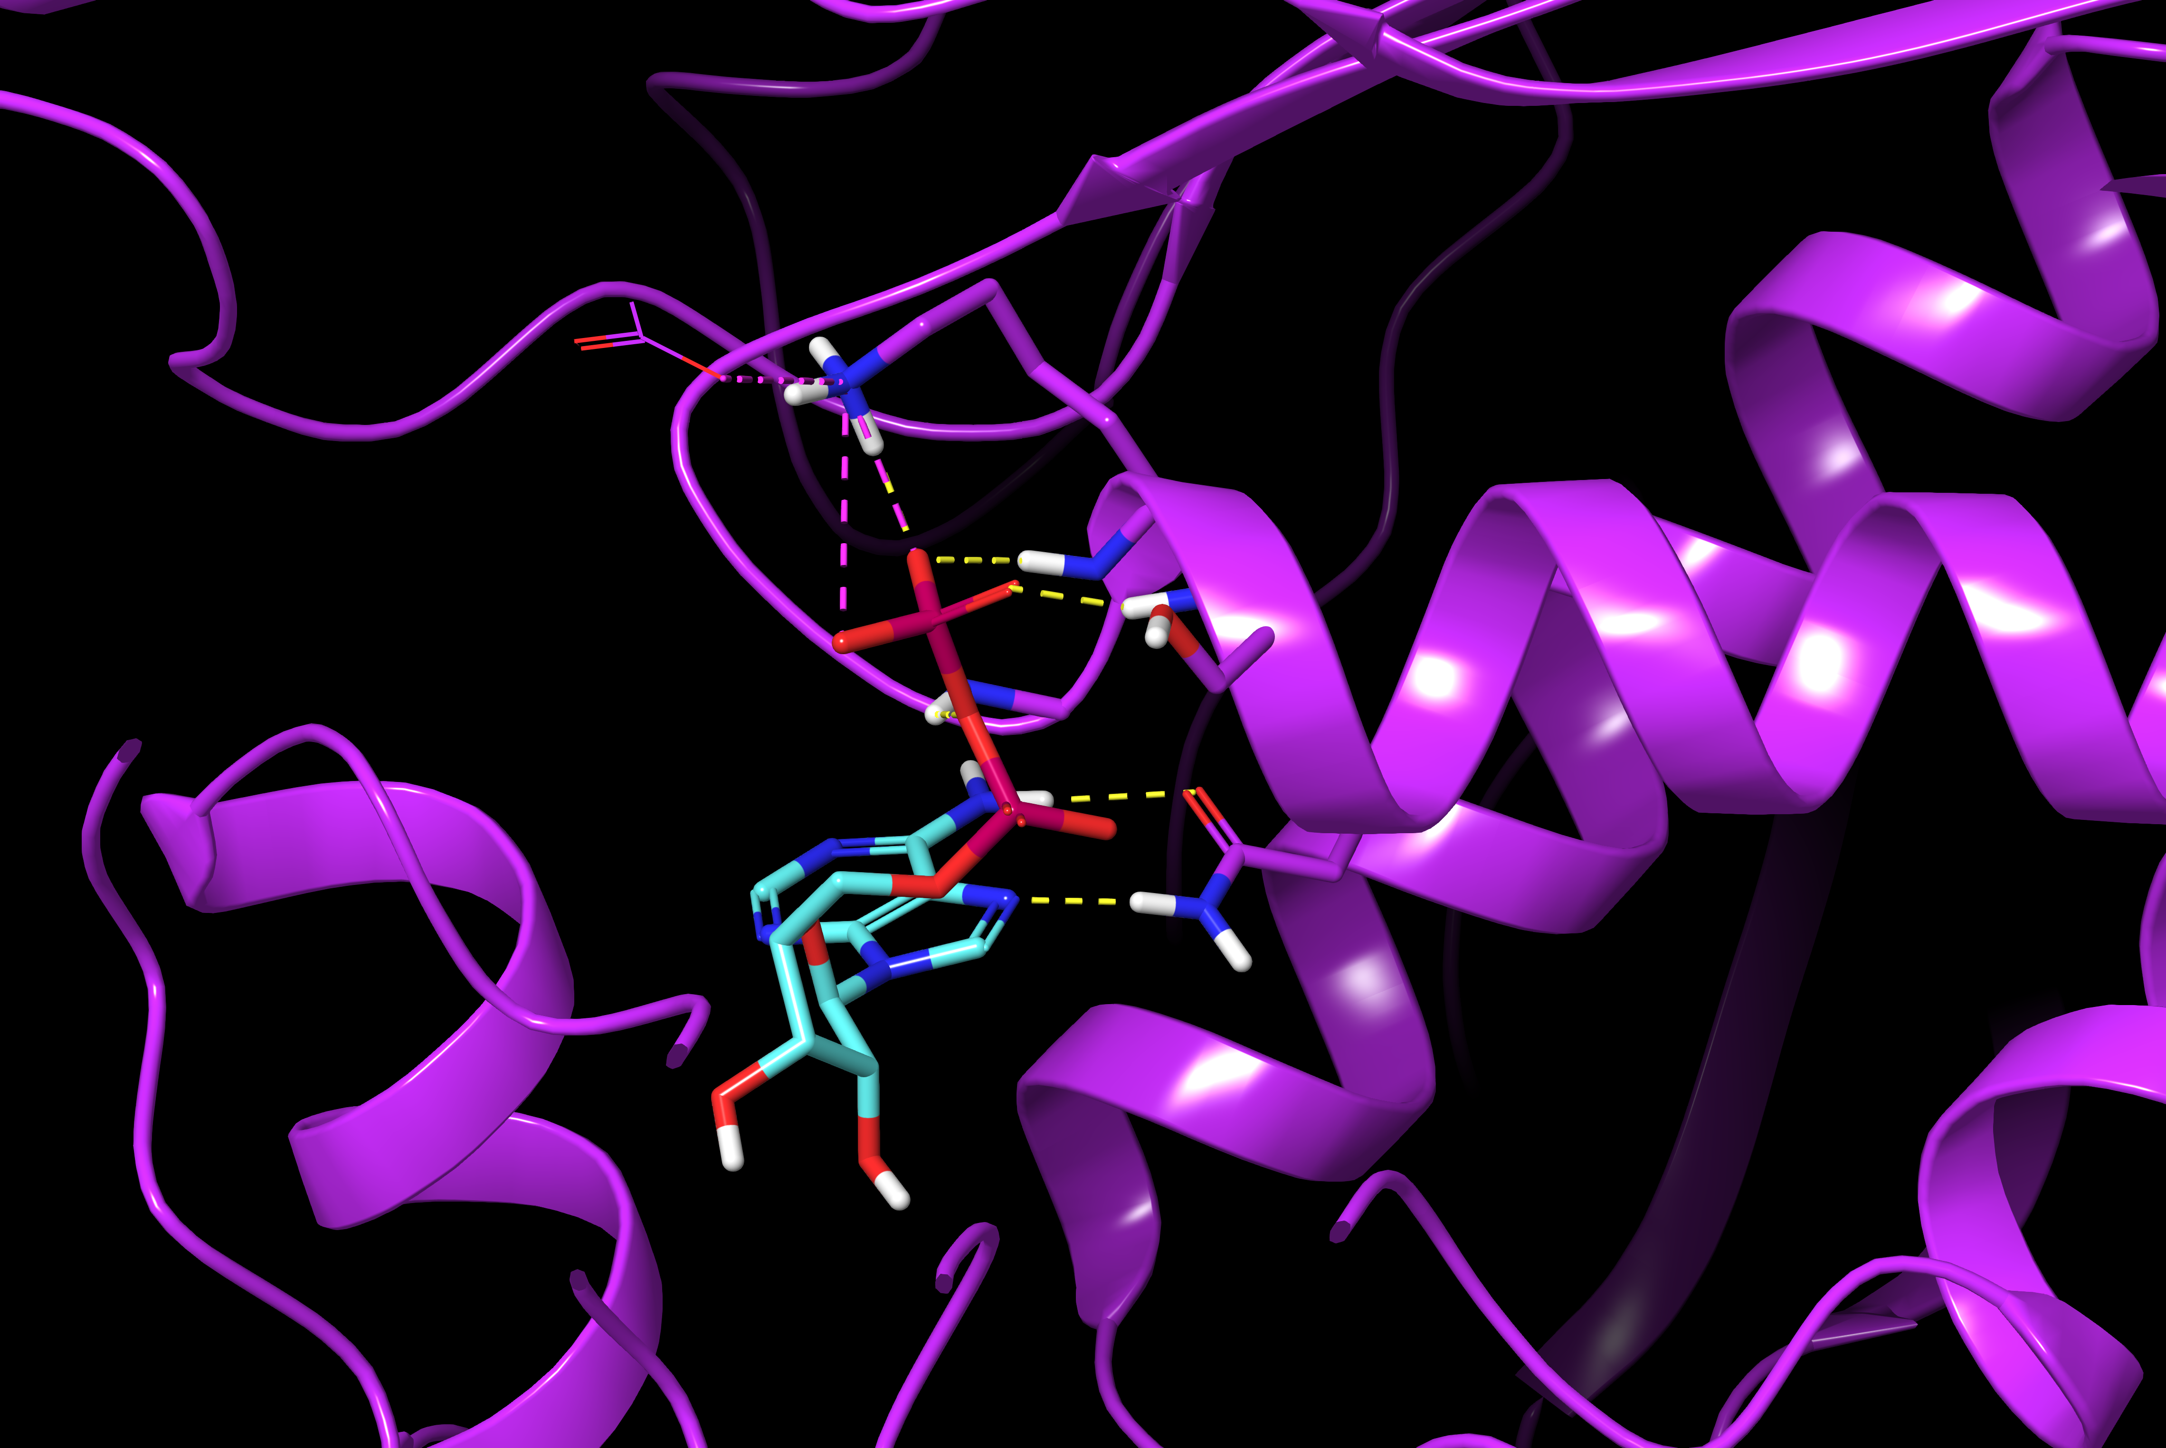
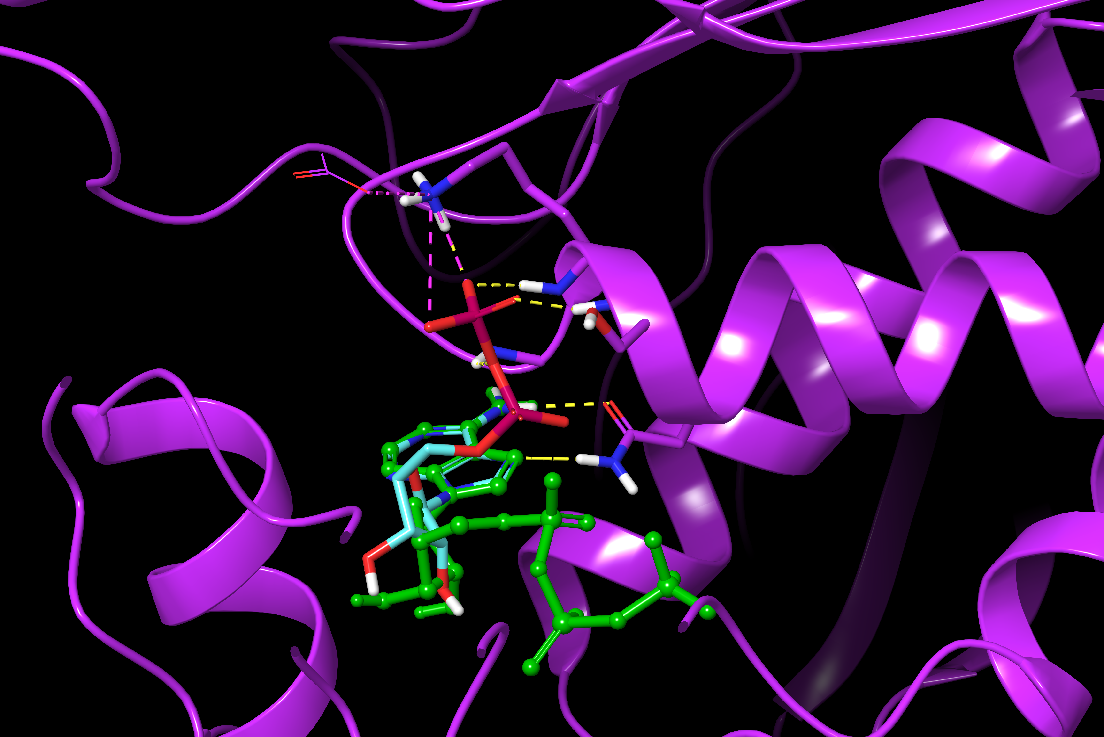
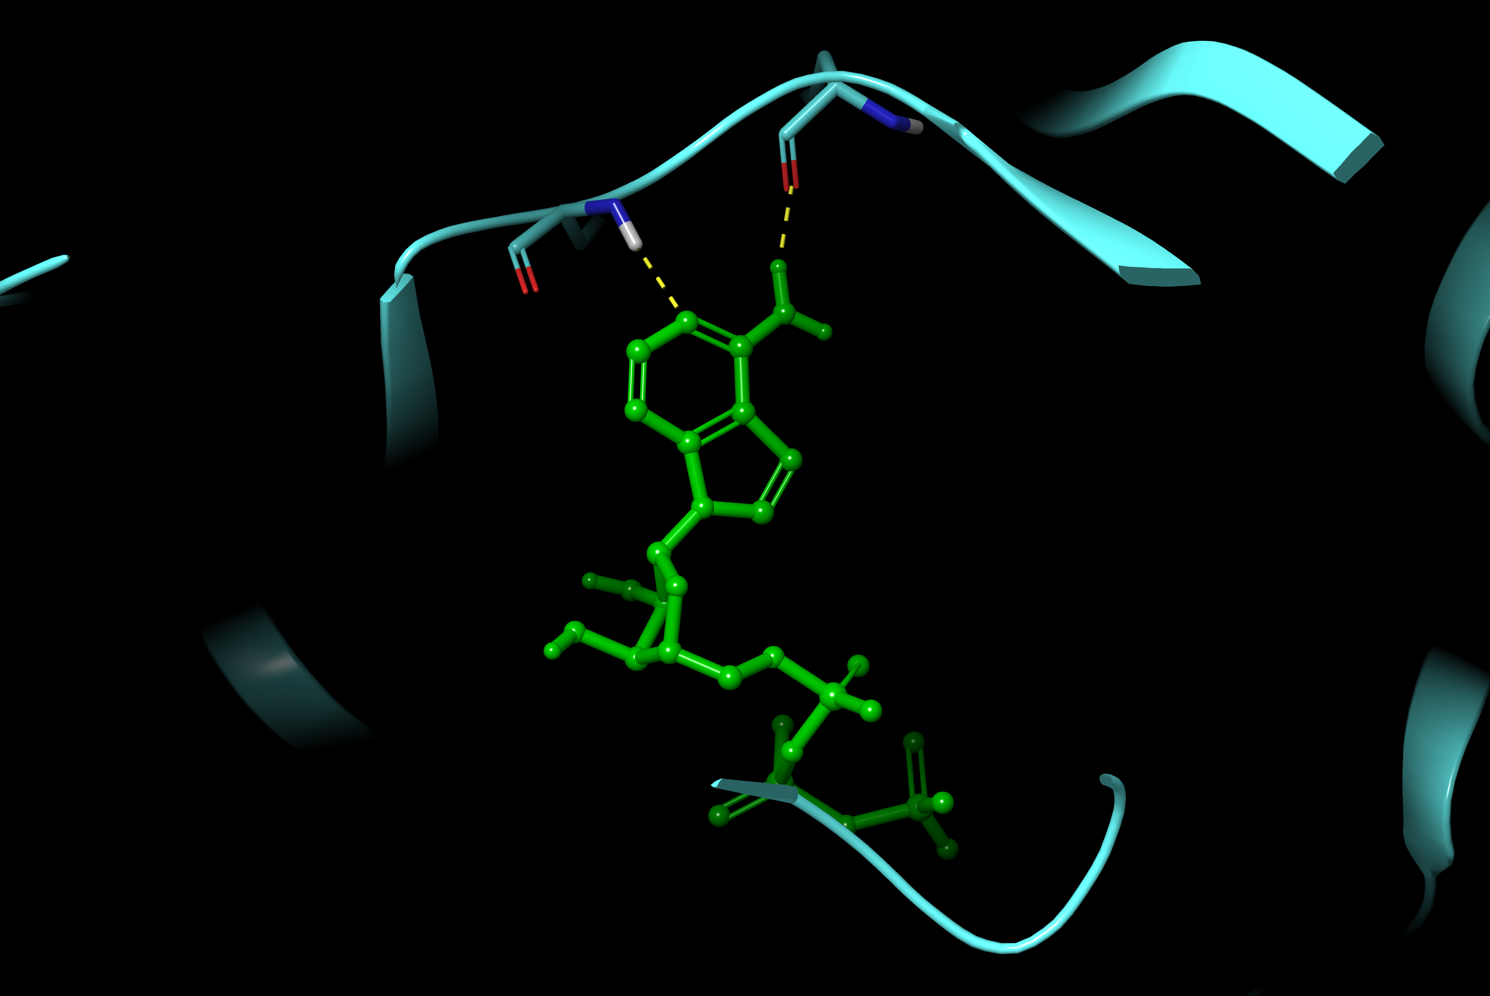
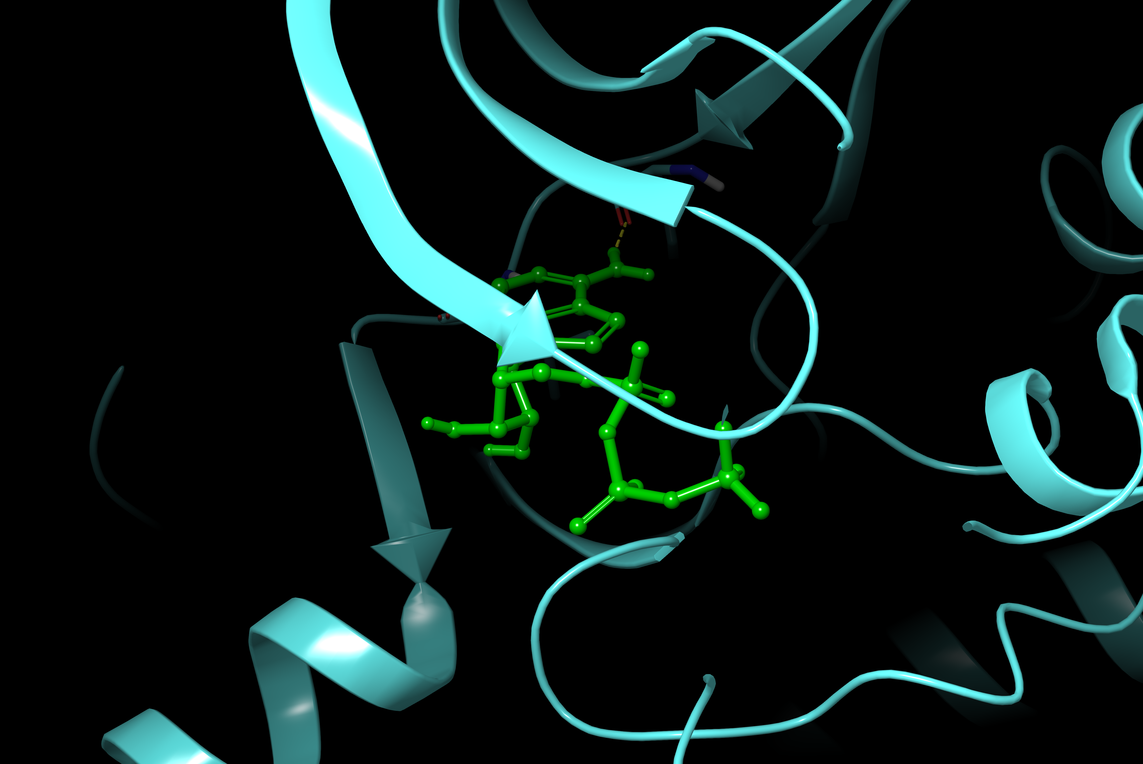
ADP/ATP Binding Site Comparison of Human Kinases and Bacterial Mur Ligases
N271
E. coli
murD
Ligase
N271
2UAG
2UAG
N271
Hinge
Hinge
Human
CDK2
Kinase
P Loop
murD ADP forms H-bonds to
end of murD helix – significant
difference to ATP interaction with
catalytic lysine in human kinases
1HCK
1HCK

